Slide 1


IMDB-Movie Analysis
: Vivek Kushawaha

Slide 2
Project description
The given project asks us to analyse IMDB Movie data.
In The dataset provided is related to IMDB Movies. A potential problem to investigate could be: "What factors influence the success of a movie on IMDB?" Here, success can be defined by high IMDB ratings. The impact of this problem is significant for movie producers, directors, and investors who want to understand what makes a movie successful to make informed decisions in their future projects.

Slide 3
Approach
The required analysis was done with the help of various functions, formulae and tools which excel provides us.
Five 'Whys' approach.
Cleaning data (Dropping columns, removing null values, etc ).
Perform Analysis: Joined the data bits and structured the tables to derive business insights, used pivot tables, fetched the required results and hence, created useful insights for the company to take calculated and planned decisions.

Slide 4
Tech STACK
MS Excel is used for the analysis.
The ease of use and familiarity with the tool is the reason for its selection.
Excel File
PowerPoint is used for presentation.

Slide 5
INSIGHTS

Slide 6
Data cleaning
Blanks and unwanted columns were cleaned.
Columns were reduced from 28 to 15.
After removing null values, the rows were reduced from 5044 to 3855.
Removed all the special character present in Genre Column.
Removed all the duplicate value

Slide 7
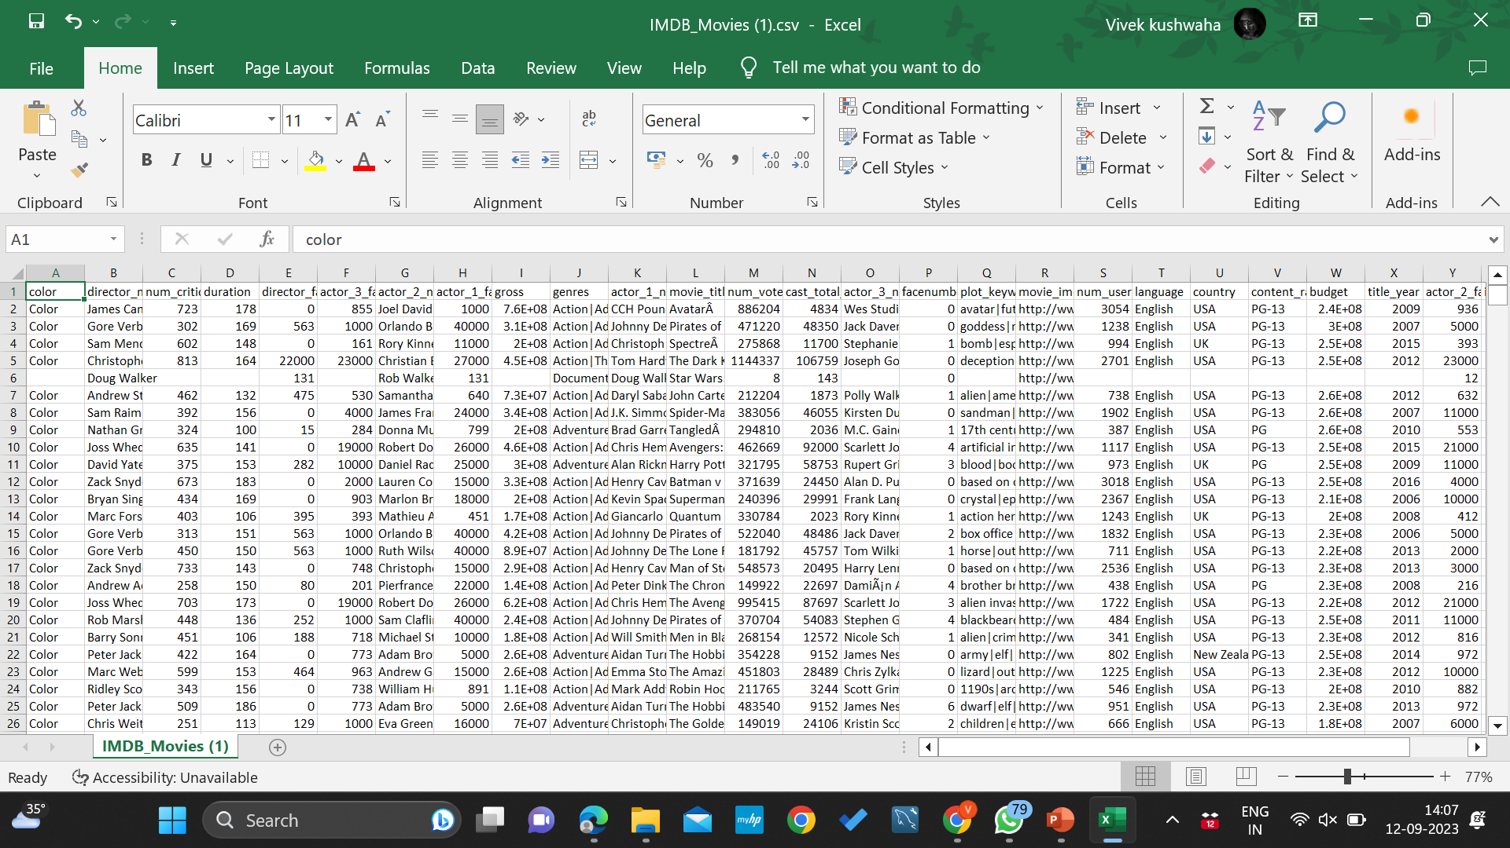
Raw Data:

Slide 8
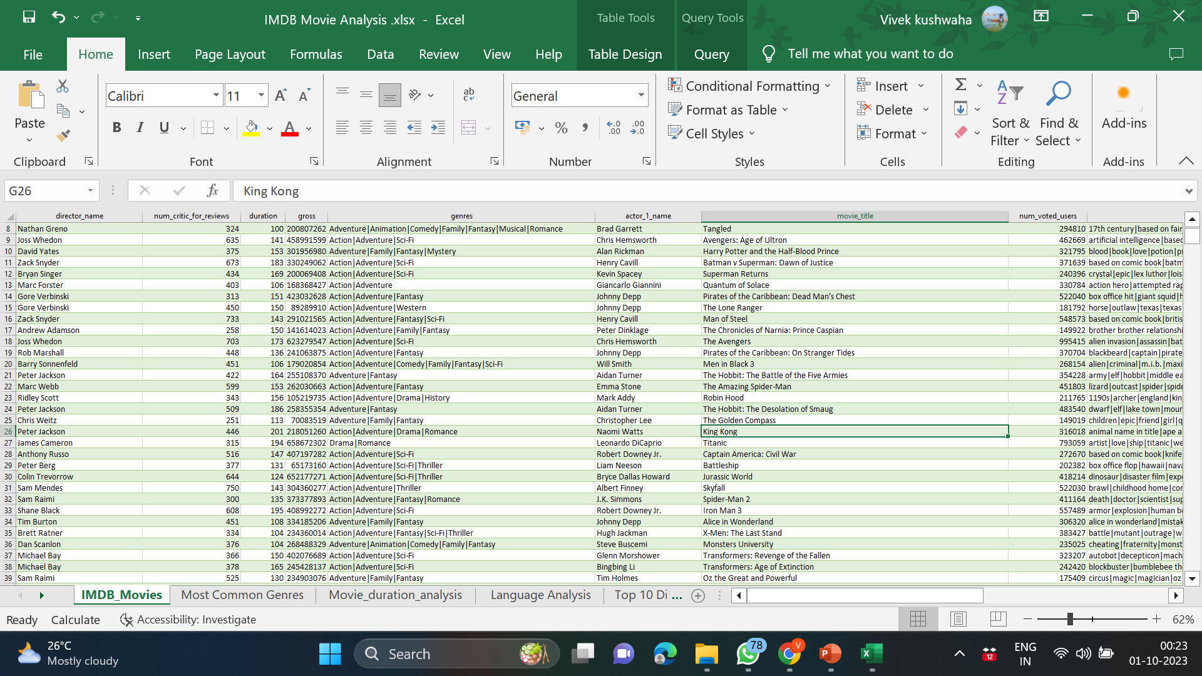
Cleaned Data:

Slide 9
1.Movie Genre Analysis
Analyze the distribution of movie genres and their impact on the IMDB score.
Determine the most common genres of movies in the dataset. Then, for each genre, calculate descriptive statistics (mean, median, mode, range, variance, standard deviation) of the IMDB scores.

Slide 10
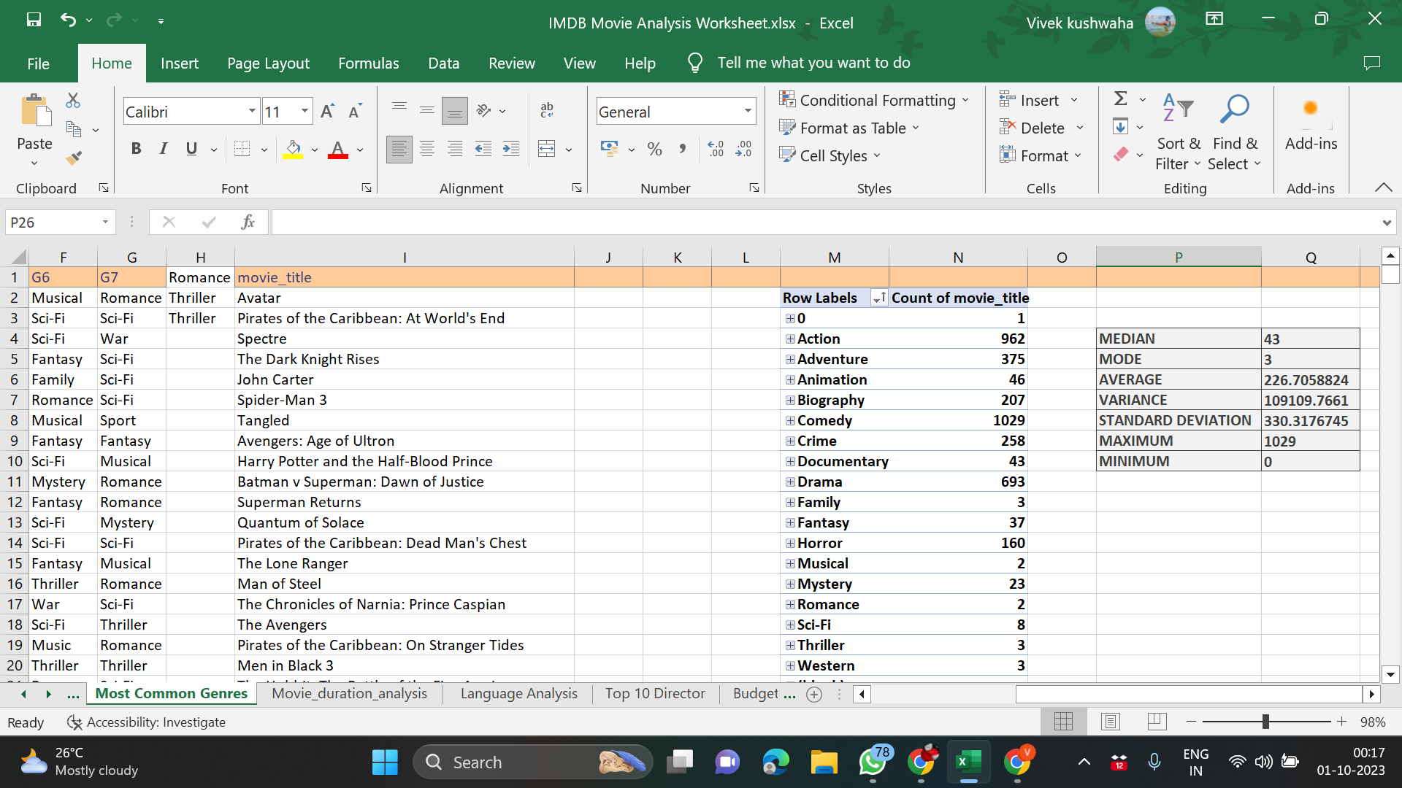
Common GENRES
Insights
Comedy, Action and Drama are the common Genres.

Slide 11
2. Movie Duration Analysis
Analyze the distribution of movie durations and its impact on the IMDB score.
Task: Analyze the distribution of movie durations and identify the relationship between movie duration and IMDB score.
Used Excel's functions like AVERAGE, MEDIAN, and STDEV. Create a scatter plot to visualize the relationship between movie duration and IMDB score. Add a trendline to assess the direction and strength of the relationship.

Slide 12
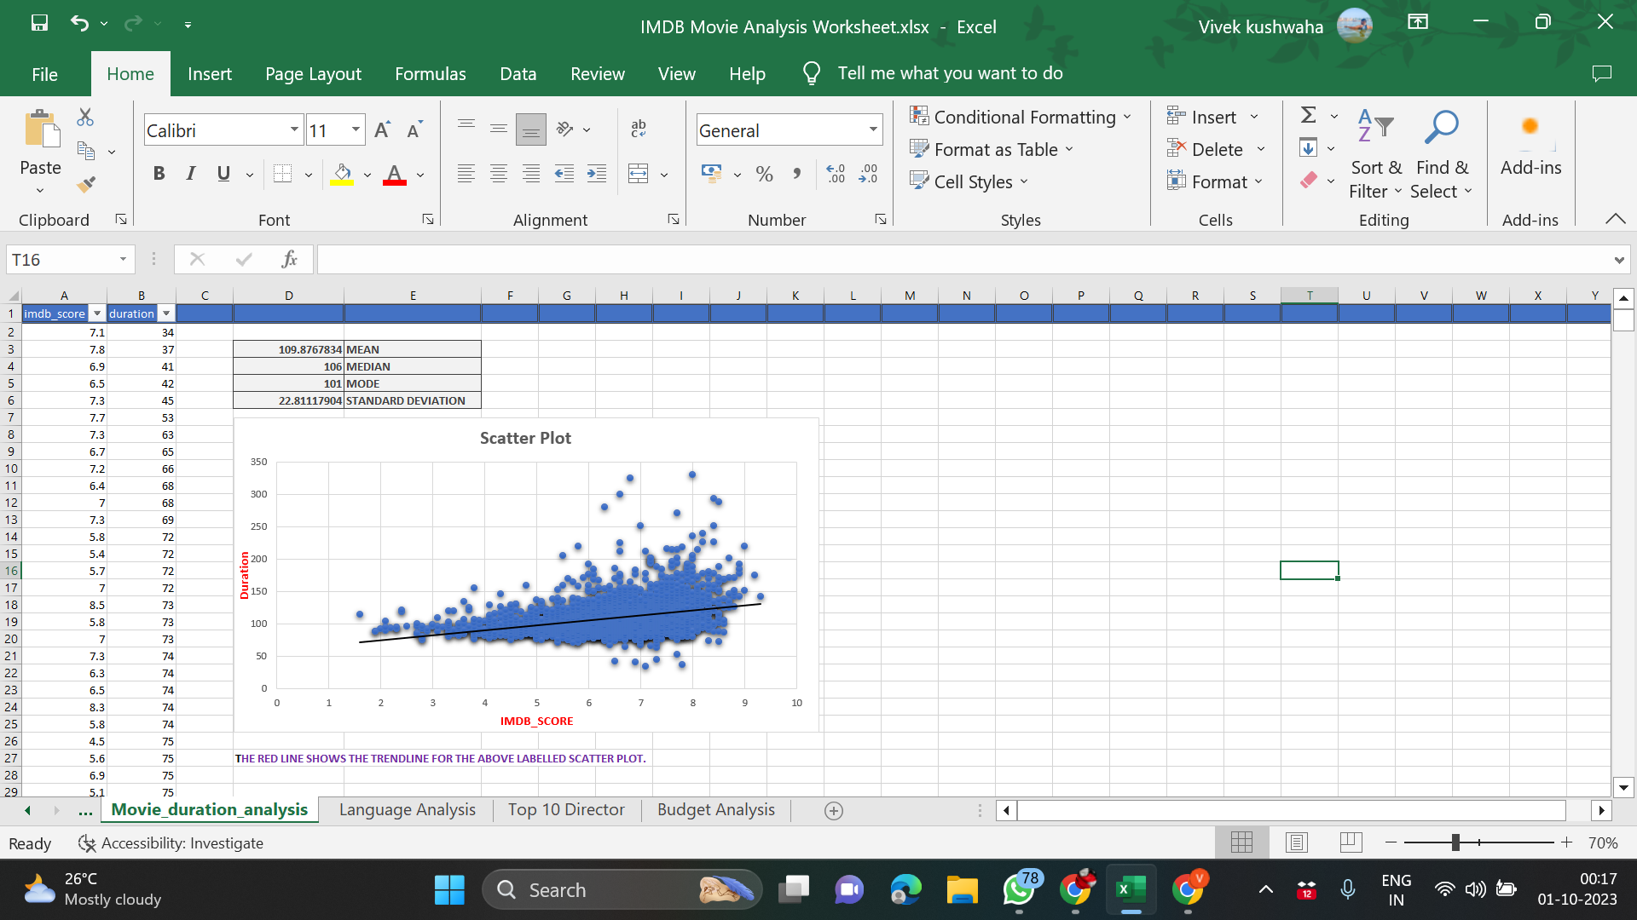

Slide 13
3.Language Analysis
Situation: Examine the distribution of movies based on their language.
Task: Determine the most common languages used in movies and analyze their impact on the IMDB score using descriptive statistics.
The most common languages used in movies is English .

Slide 14
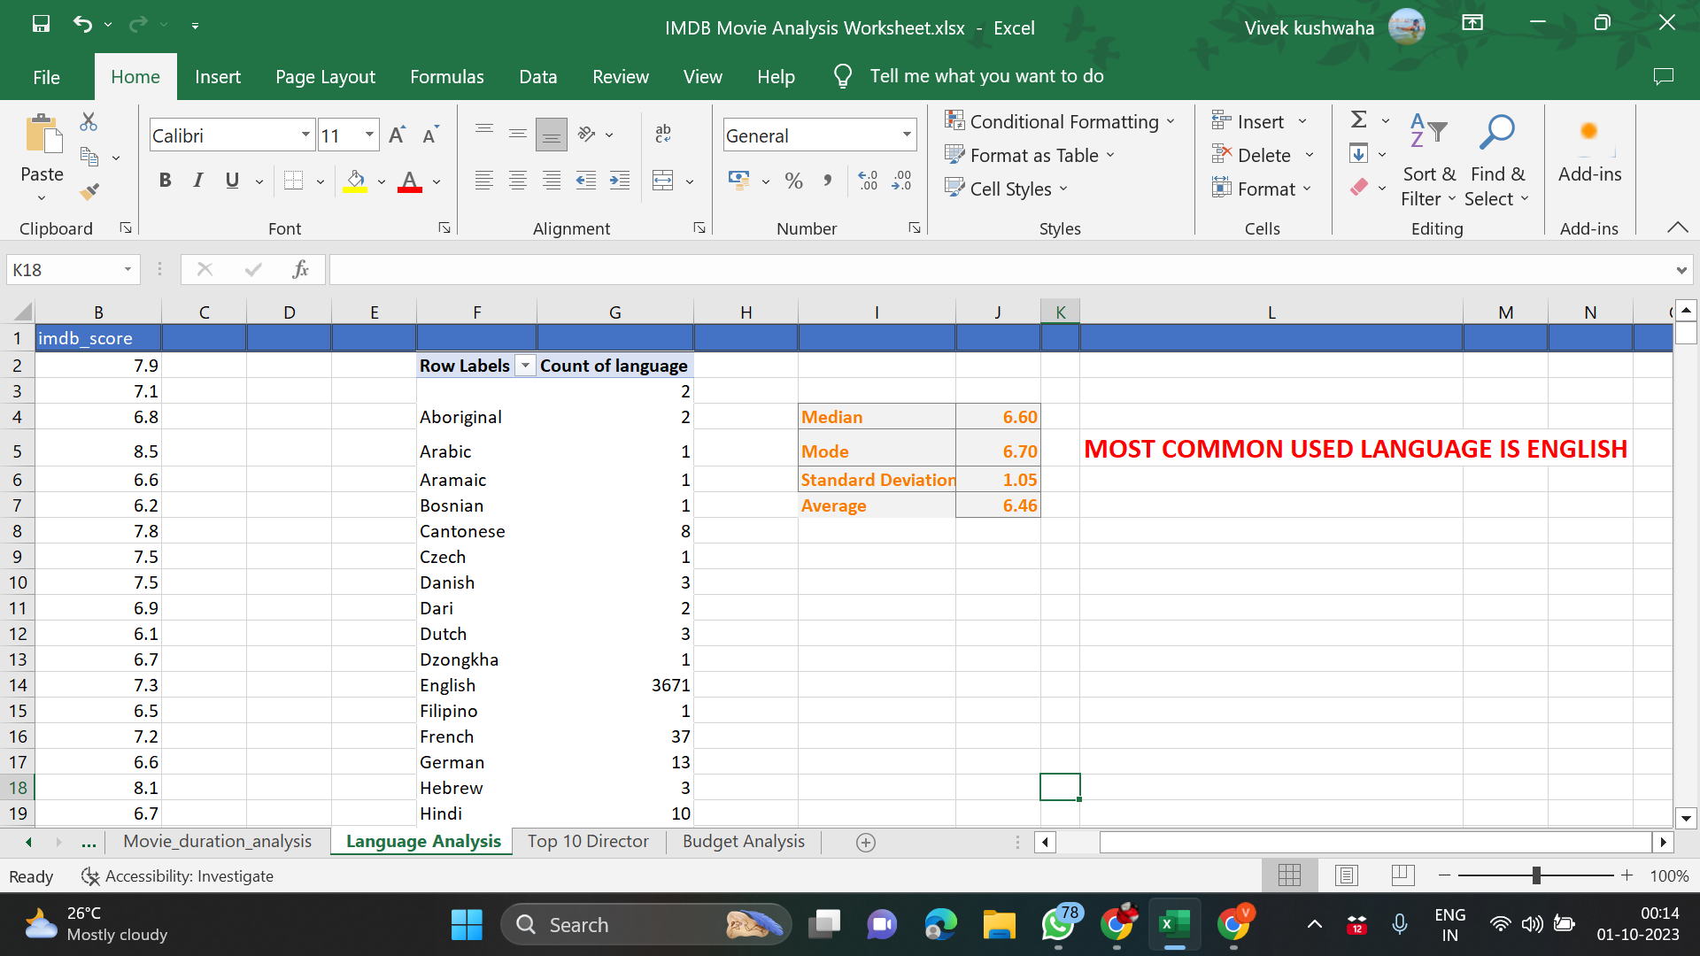
Most used language is English.

Slide 15
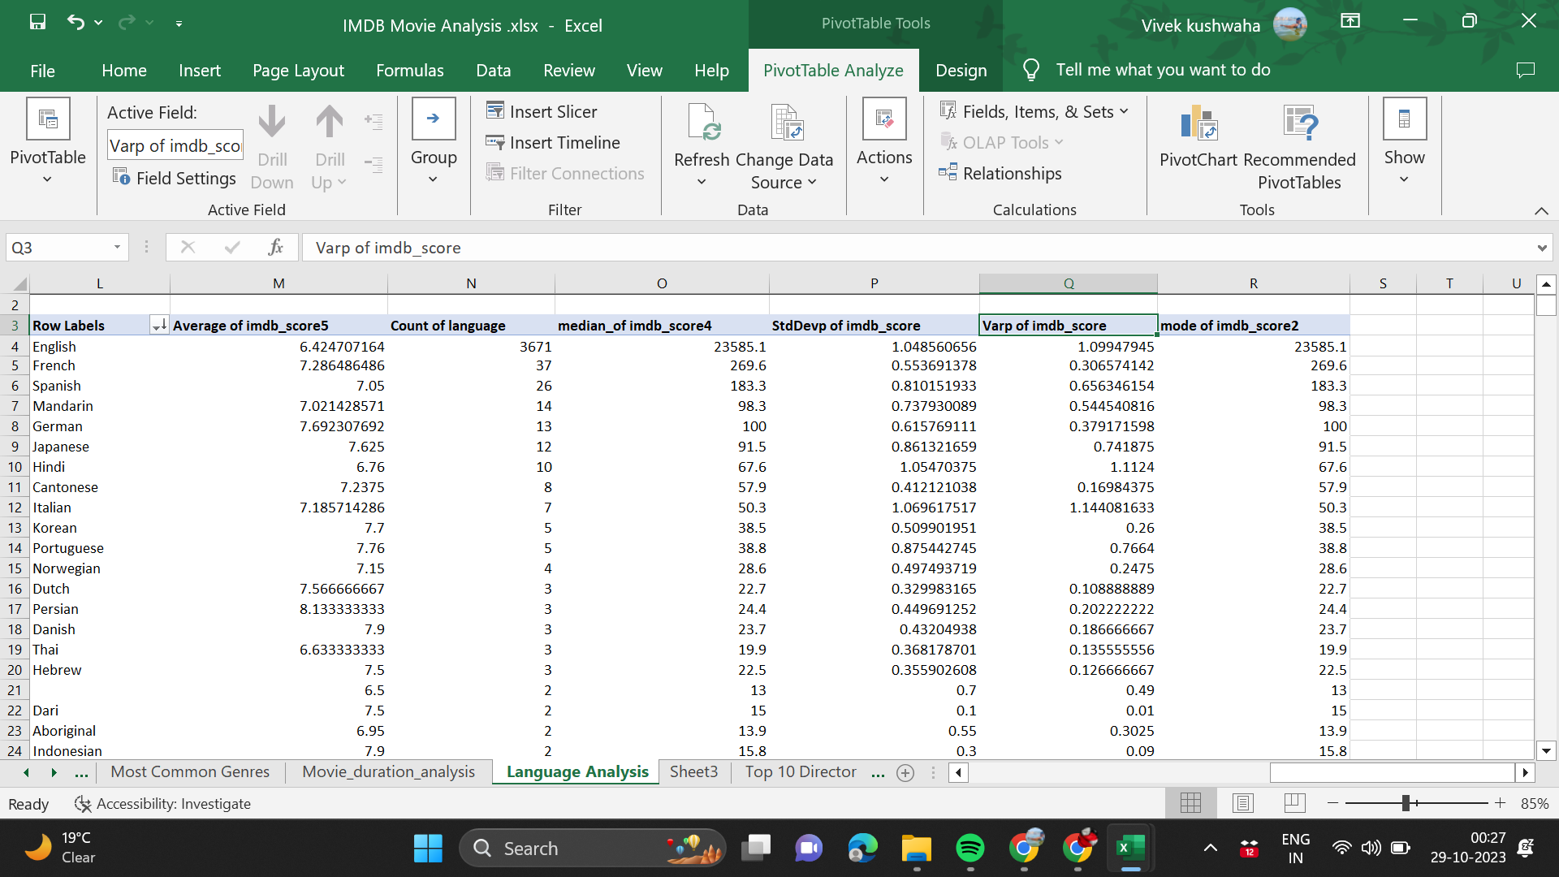
Descriptive Analysis:

Slide 16
4.Top Directors
Influence of directors on movie ratings.
Task: Identify the top directors based on their average IMDB score and analyze their contribution to the success of movies using percentile calculations.
Formula used:
=LARGE(B2:B14,1)
=PERCENTRANK(B2:B14,8.6)
=PERCENTILE(B2:B14,F3)

Slide 17
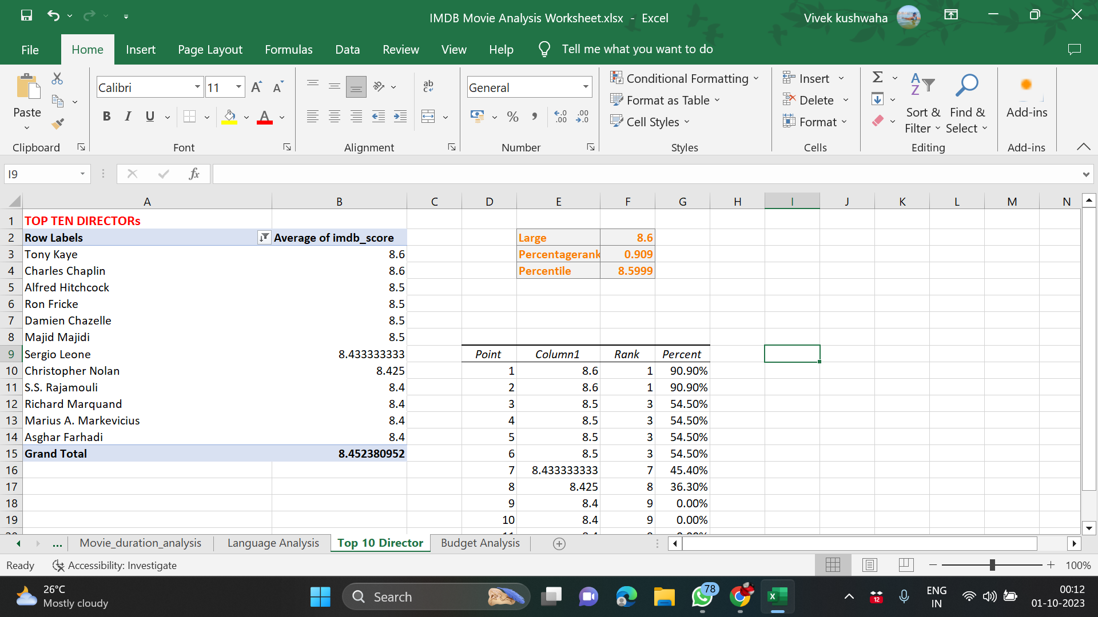

Slide 18
5. BUDGET ANALYSIS
Explore the relationship between movie budgets and their financial success.
Task: Analyze the correlation between movie budgets and gross earnings, and identify the movies with the highest profit margin.
INSIGHT:
The budget doesn’t increase when the gross earning increases, or vice-versa.
Formula used:
=CORREL(A:A,B:B) for correlation.
=MAX(RANGE) for highest profitability.

Slide 19
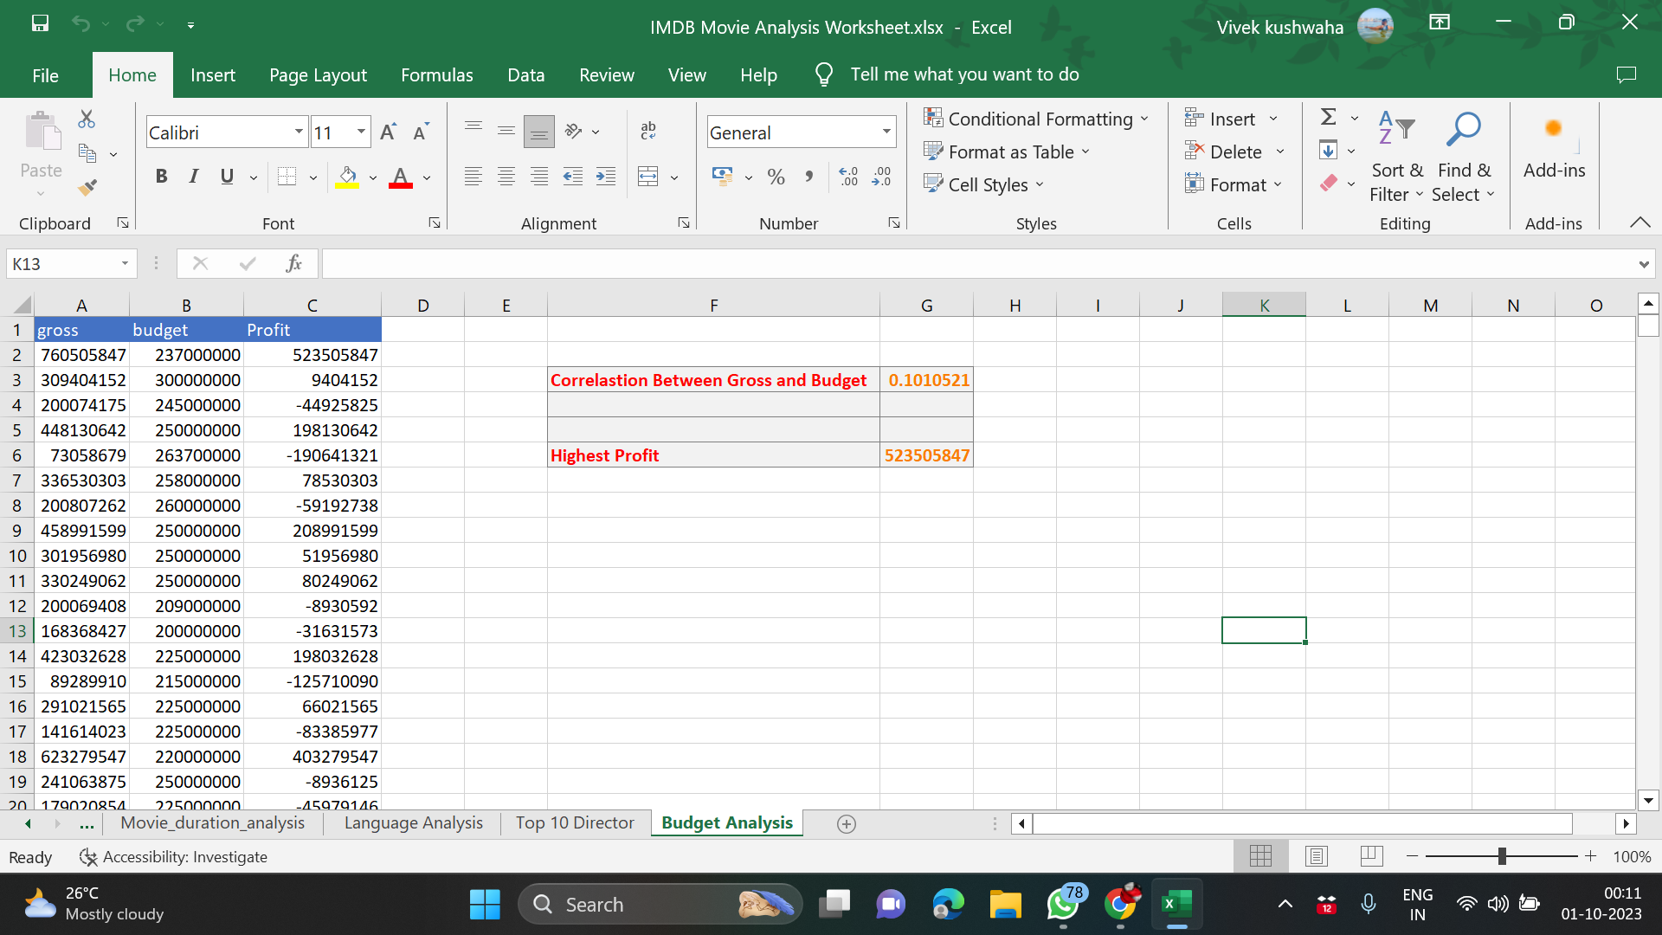

Slide 20
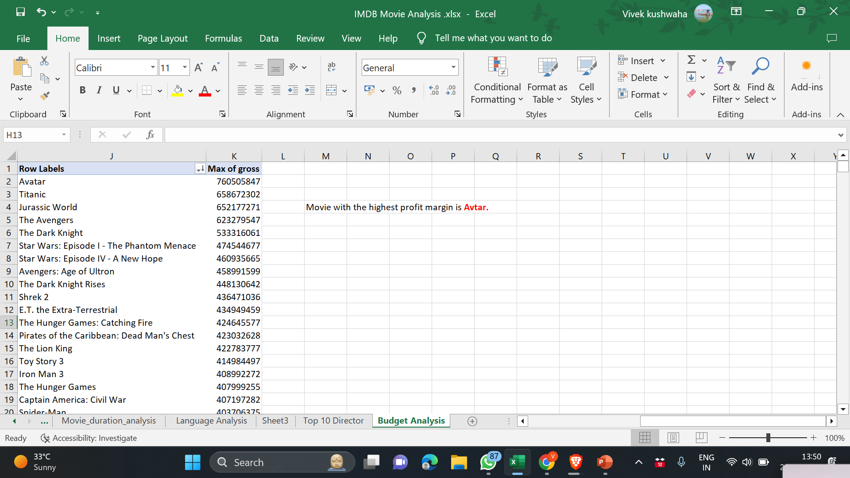
Movie with highest profit margin is “Avtar”.

Slide 21
Link of worksheet is mentioned below
https://docs.google.com/spreadsheets/d/1tr-OX_0GqdH4O1TR2rqqvkRANbl7JBDE/edit?usp=drive_link&ouid=107522417124927572865&rtpof=true&sd=true

Slide 22
RESULT
The given project helped me gain mastery in pivot tables, formulas and functions.
This helped in establishing an advance understanding for MS Excel.
Thank You ☺☺☺☺

